Slide 1
Negative triangularity research - progress across the world
F. Sciortino, T. Pütterich, J. Hobirk, B. Vanovic, B. Zimmermann, D. Brida, M. Dunne, E. Fable, A. Kallenbach, R. Dux, M. Cavedon, R. McDermott, T. Bolzonella, T. Lunt, R. Fischer, D. Stieglitz, P. Mantica, A. Mariani, O. Février, …, AUG Upgrade Team and EUROfusion RT07 Team´
Max-Planck-Institut für Plasmaphysik | F. Sciortino | 12/09/22
Interpretative edge modeling

Slide 2
Worldwide interest in ELM-free high-performance operation
Switzerland: TCV Team, decades of pioneering work (e.g. Coda et al 2022 Plasma Phys. Control. Fusion 64 014004)
Japan: M. Kikuchi et al. 2019 Nucl. Fusion 59 056017
Russia: S.Yu. Medvedev et al. 2015 Nucl. Fusion 55 063013
USA: DIII-D Team, starting from Austin et al. 2019 PRL 122 115001 & Marinoni et al. 2019 PoP 26 042515
AUG: first device to test NT plasmas with a W wall, Happel et al. 2022, accepted in Nucl. Fusion
This talk offers a short discussion/selection of recent progress on the subject.

Slide 3
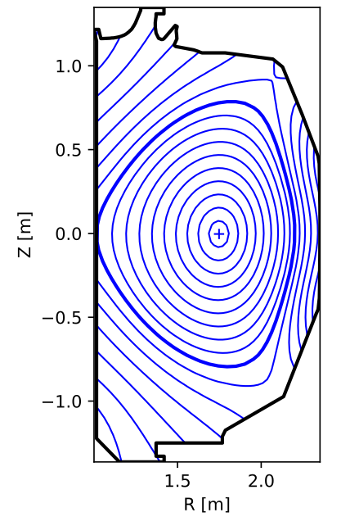
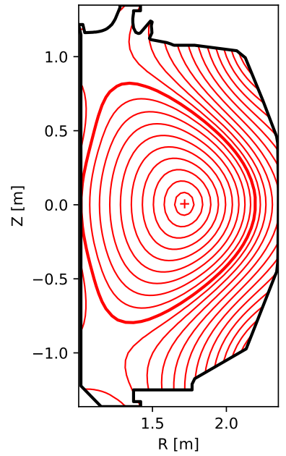

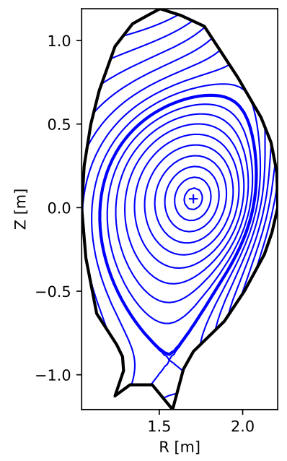
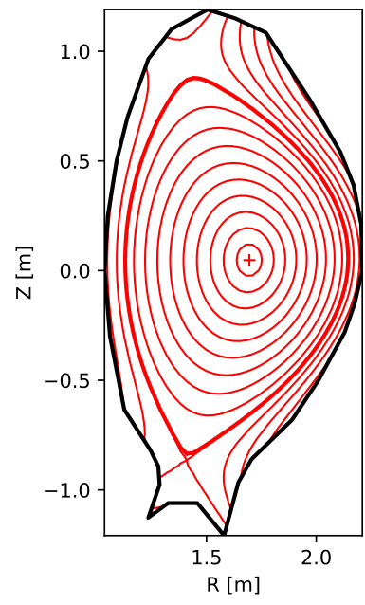
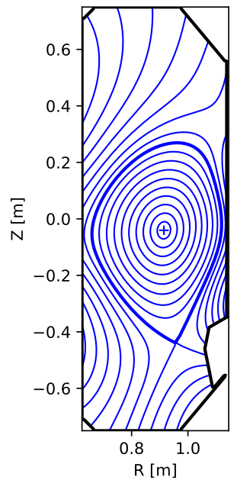
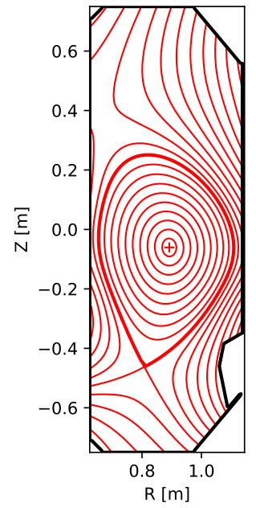


Contents
Core energy confinement
Impurity transport
Edge transport & detachment
Pedestal stability
Missing pieces

Slide 4
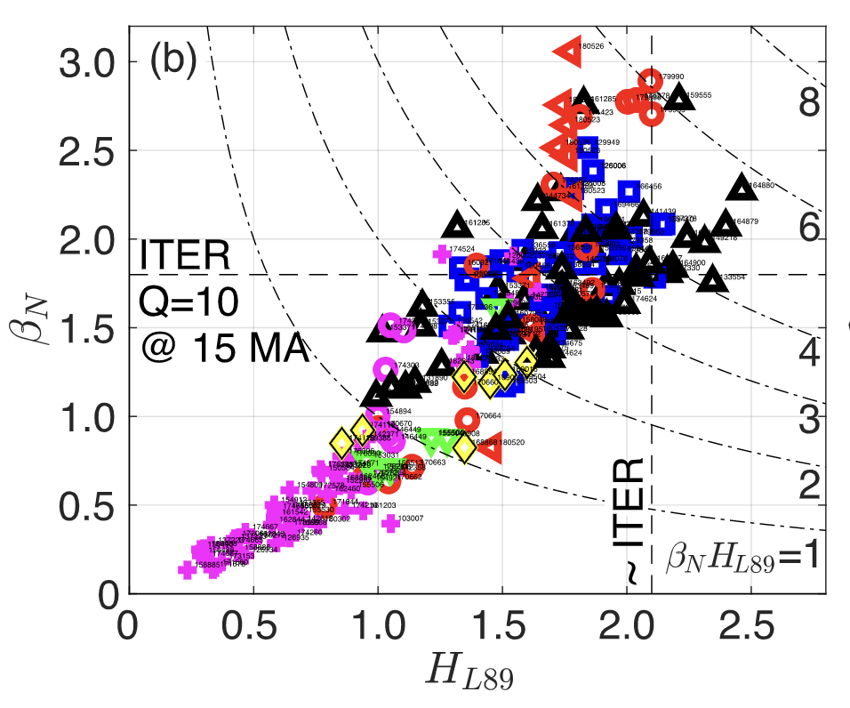
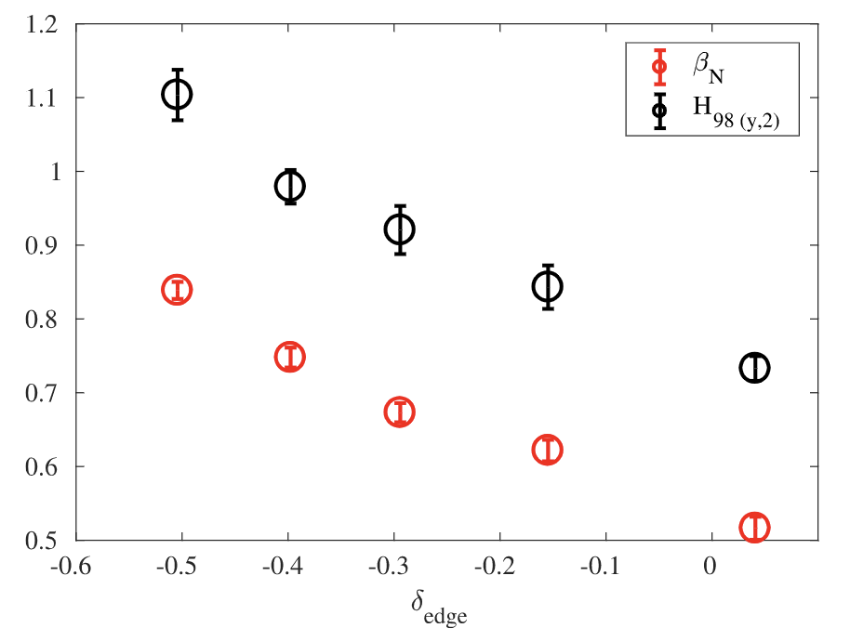
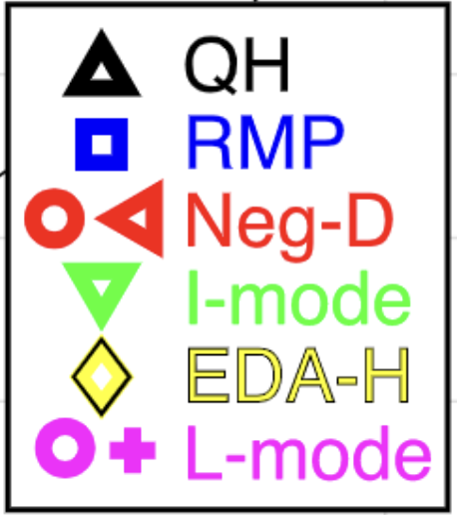
NT as a promise of high-performance core-edge integration
Negative triangularity promises ELM-free operation, with no $P_{heat}>P_{LH}$ threshold, simpler divertor operation, and therefore advanced core-edge integration
Paz-Soldan et al 2021 Plasma Phys. Control. Fusion 63 083001
Coda et al 2022 Plasma Phys. Control. Fusion 64 014004

Slide 5
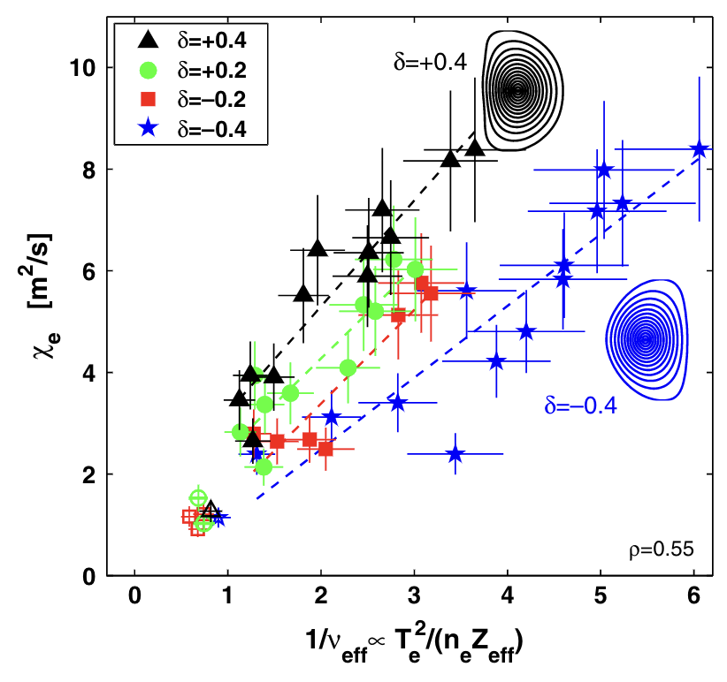
TCV finds low turbulence levels, both in the core and SOL
Over time, TCV has characterized turbulence in NT
in early TEM-dominated plasmas
later, in plasmas with Ti/Te~1, including ITG
Camenen et al. Nucl. Fusion 47 (2007) 510–516

Slide 6
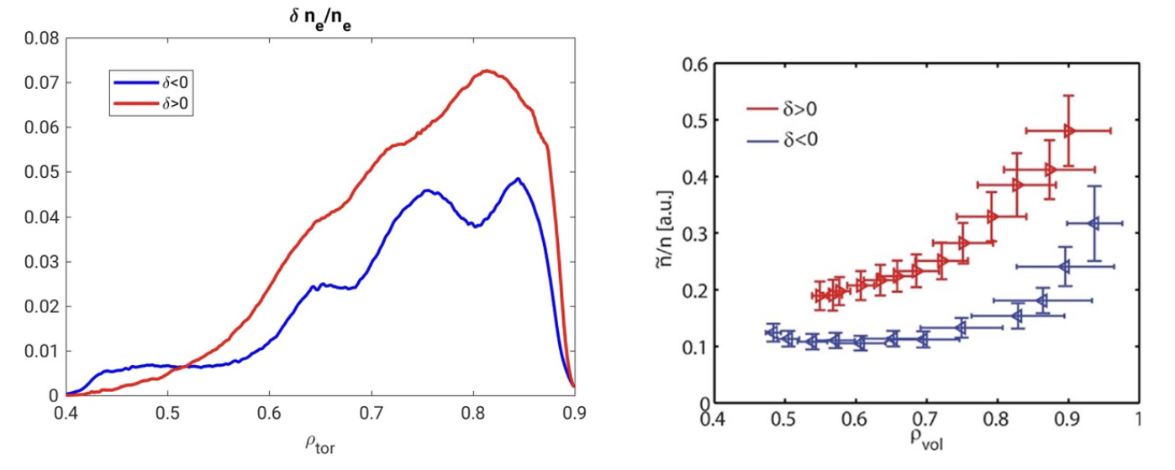
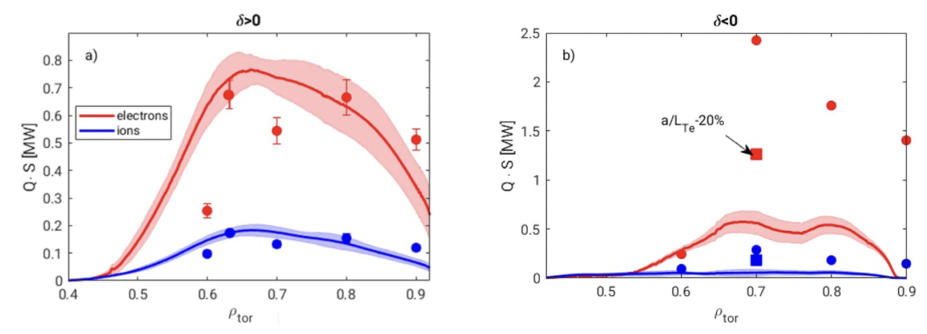
TCV finds low turbulence levels, both in the core and SOL
Over time, TCV has characterized turbulence in NT
in early TEM-dominated plasmas
later, in plasmas with Ti/Te~1, including ITG
Huang (PCI) & Fontana (CECE) showed consistent reduction of $n_{e}$ and $T_{e}$ fluctuations across radius
Recently, Merlo et al. showed that global (nonlinear) gyrokinetic simulations can capture nonlocal effects and match experimental measurements well
Global GENE
Expt (PCI)
Global
Merlo et al. PPCF 63 (2021) 044001
Flux tube

Slide 7
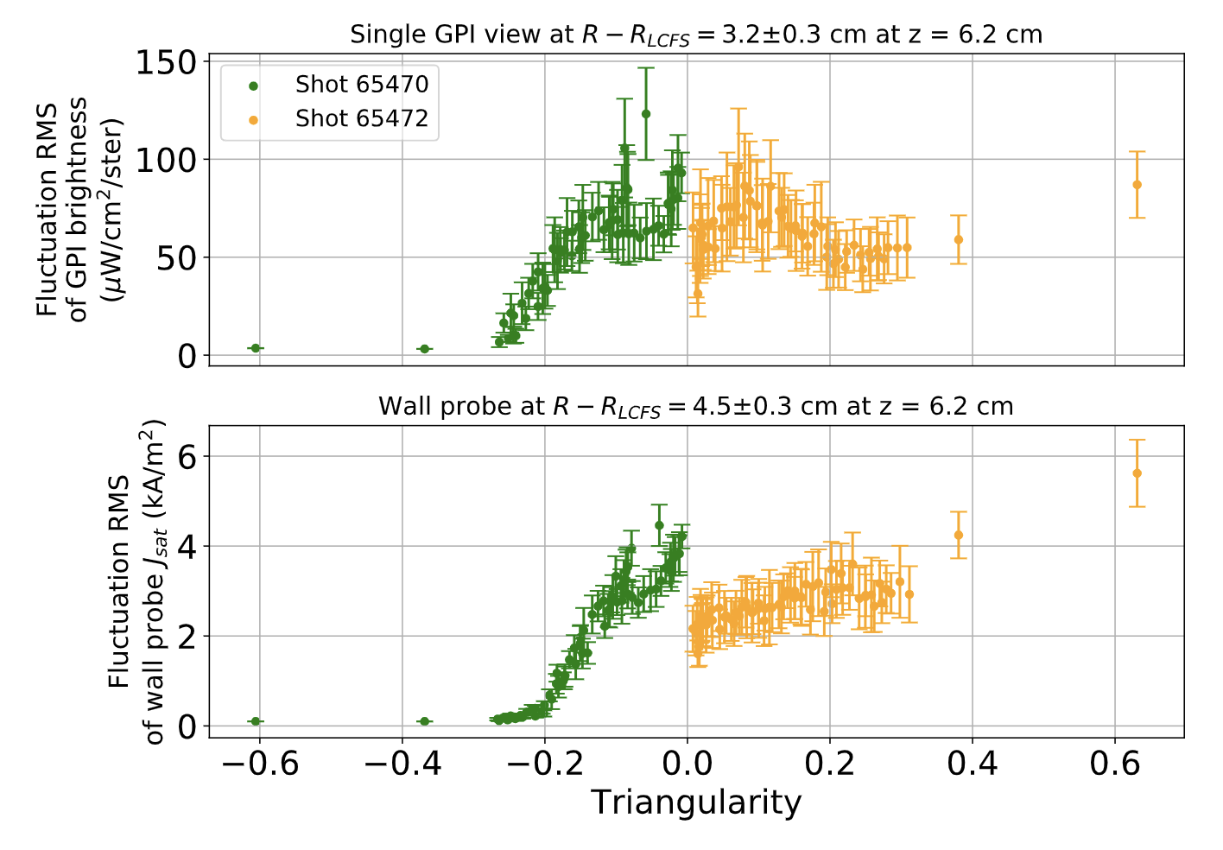
TCV finds low turbulence levels, both in the core and SOL
Over time, TCV has characterized turbulence in NT
in early TEM-dominated plasmas
later, in plasmas with Ti/Te~1, including ITG
Huang (PCI) & Fontana (CECE) showed consistent reduction of $n_{e}$ and $T_{e}$ fluctuations across radius
Recently, Merlo et al. showed that global (nonlinear) gyrokinetic simulations can capture nonlocal effects and match experimental measurements well
Han et al. also found via Gas Puff Imaging (GPI) that fluctuations are also suppressed in the SOL in NT
GPI on TCV outer mid plane
Han et al., Nucl. Fusion 61 (2021) 034003

Slide 8
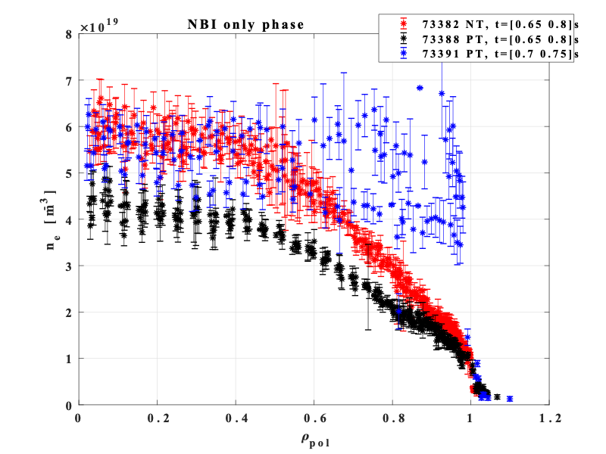
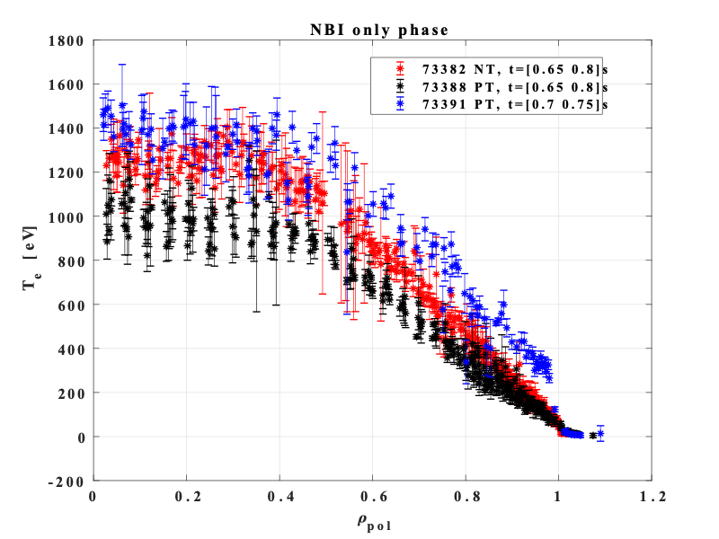
RT07 experiments on TCV show desirable effect in NT plasmas
Comparison of PT (L- & H-mode) and NT profiles (L-mode) show a “catch up” of core profiles.

Slide 9
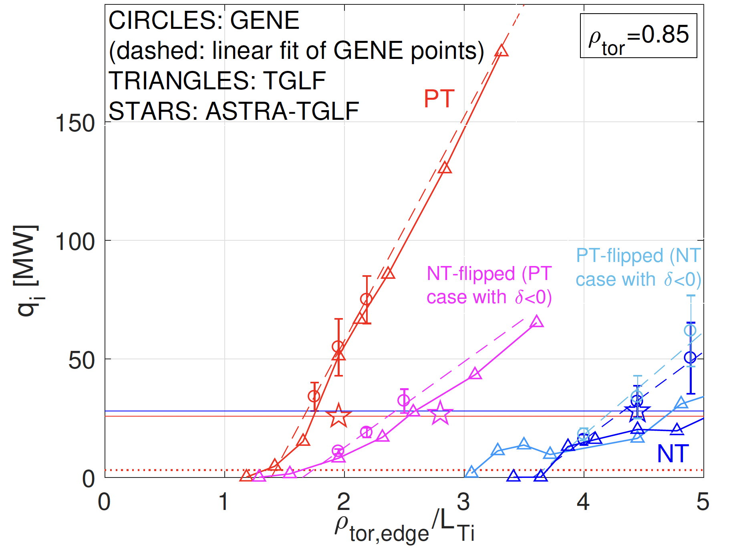
Modeling for DTT suggests NT would not be beneficial
Modeling by A. Mariani [EPS22] suggests little gain in DTT performance when kinetic profiles are representative of L-mode
- much clearer impact of NT vs. PT when using H-mode-like profiles
- TGLF and GENE agree well; similar to analysis on DIII-D with TGLF and CGYRO
H-mode profiles
L-mode profiles
F. Sciortino et al, submitted to PPCF [Jan 2022]

Slide 10
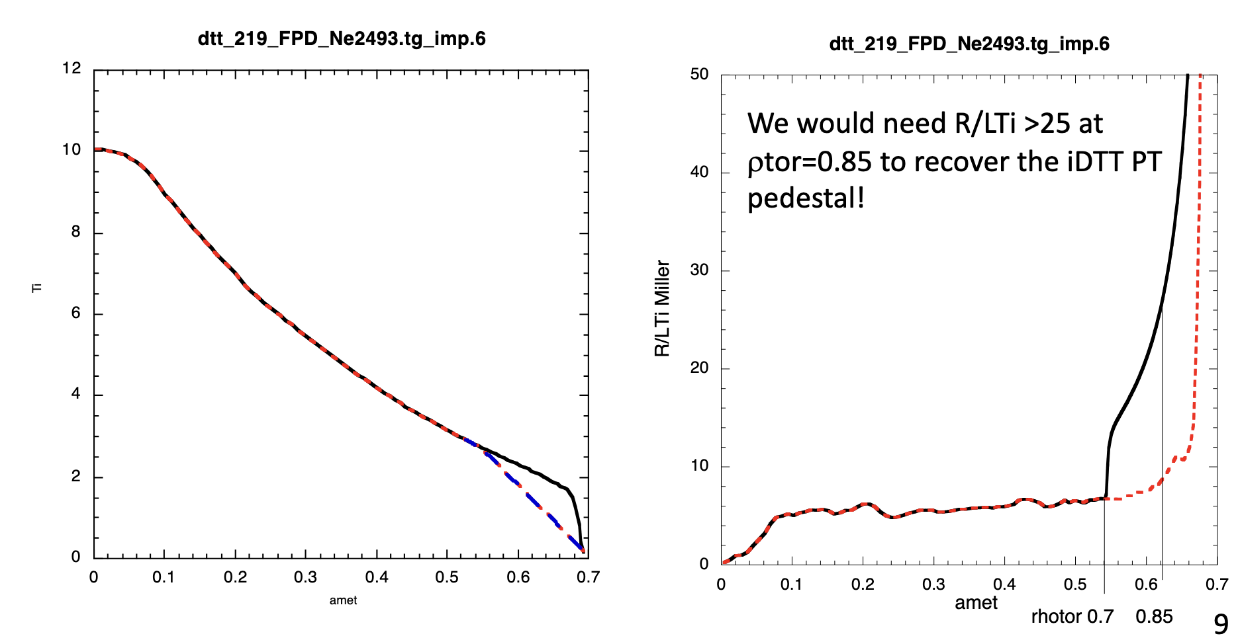
Modeling for DTT suggests NT would not be beneficial
To see “catch up” effect in NT, one would need R/LTi>25, only found with $δ≈-0.8$ —> unrealistic
A. Mariani, P. Mantica et al.

Slide 11
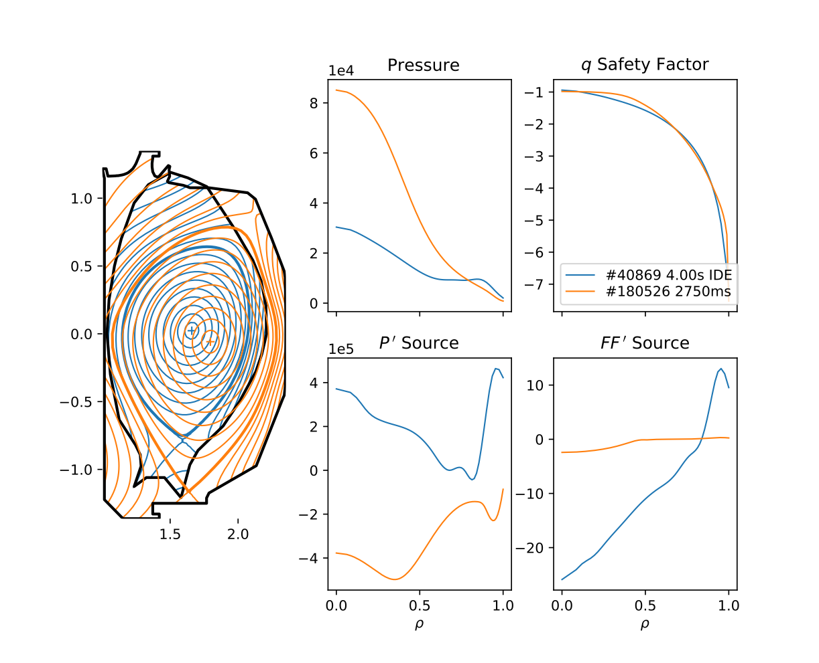
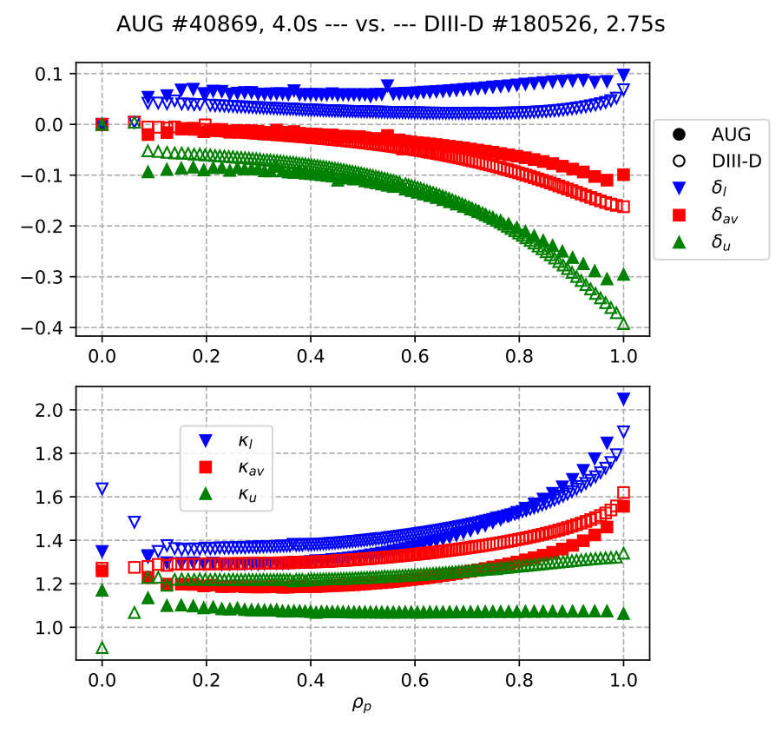
Comparable shaping parameters achieved in DIII-D and AUG
Comparison of 2 shots (arbitrary times/heating): slightly stronger shaping on DIII-D than AUG

Slide 12
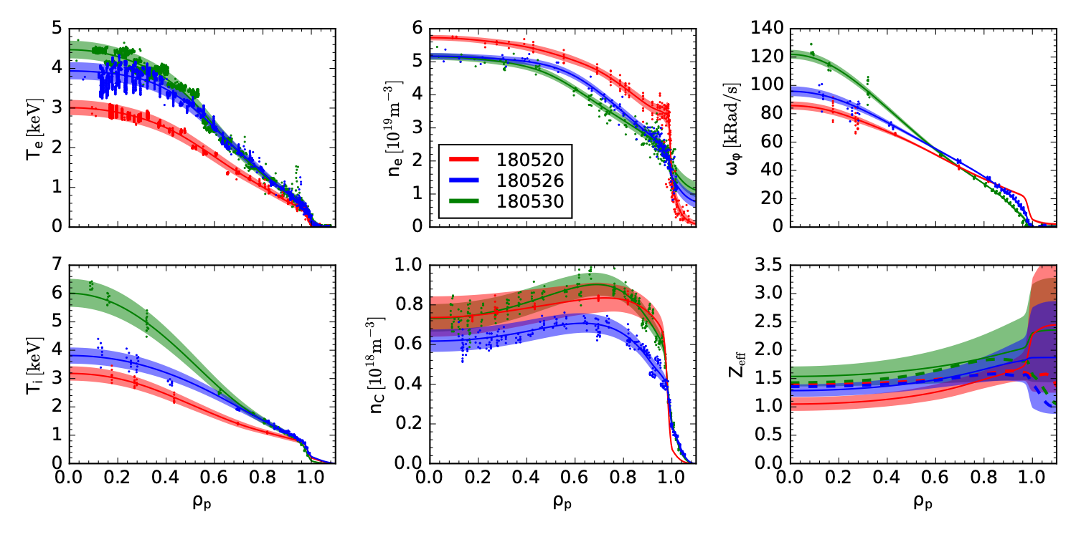
DIII-D diverted NT experiments showed favorable impurity transport, low Zeff
Sciortino et al, submitted to PPCF [Jan 2022]

Slide 13
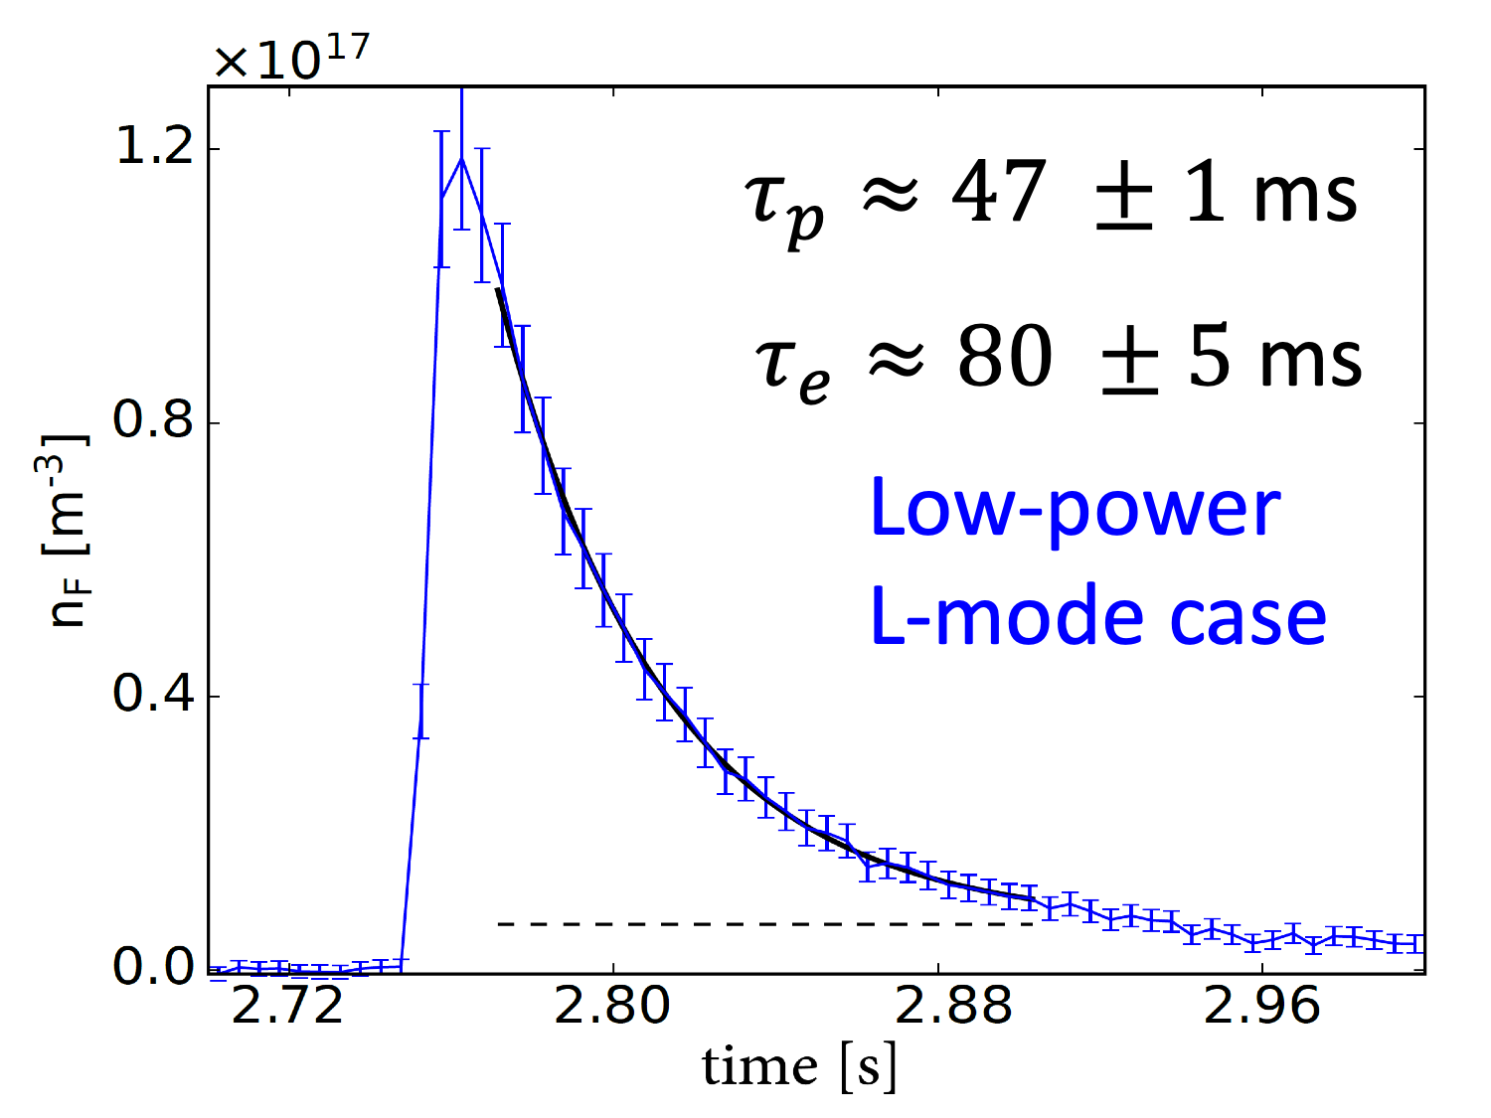
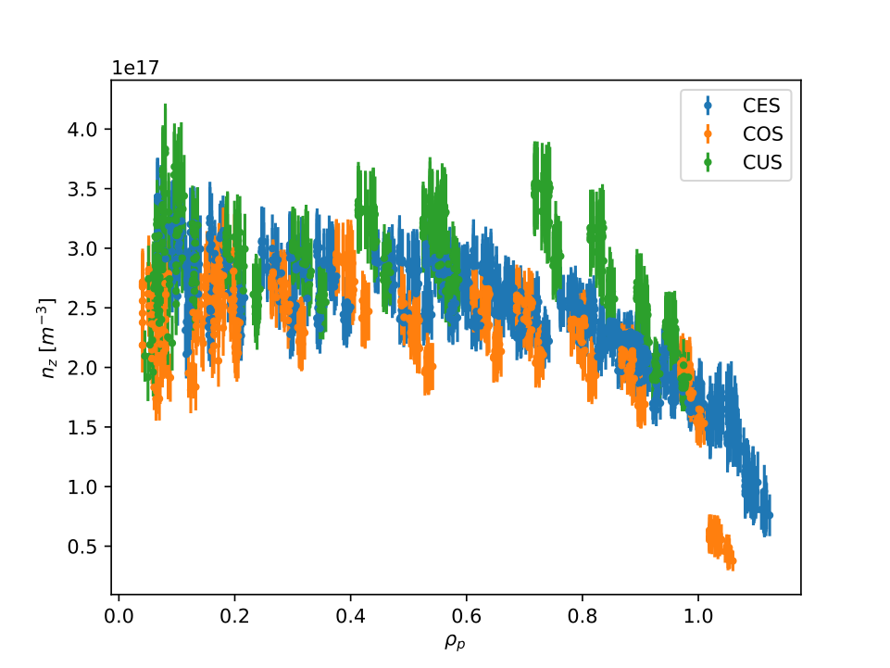

Core impurity transport observed to be favorable in NT
On both AUG and DIII-D, no evidence of impurity accumulation has been observed
At DIII-D, hollow C profiles and short impurity conf. times quantified with LBO injections
Conjectured to be driven by neoclassical physics
At AUG, disruptions did not occur because of W peaking, but stability issues
Sciortino et al, submitted to PPCF [Jan 2022]

Slide 14
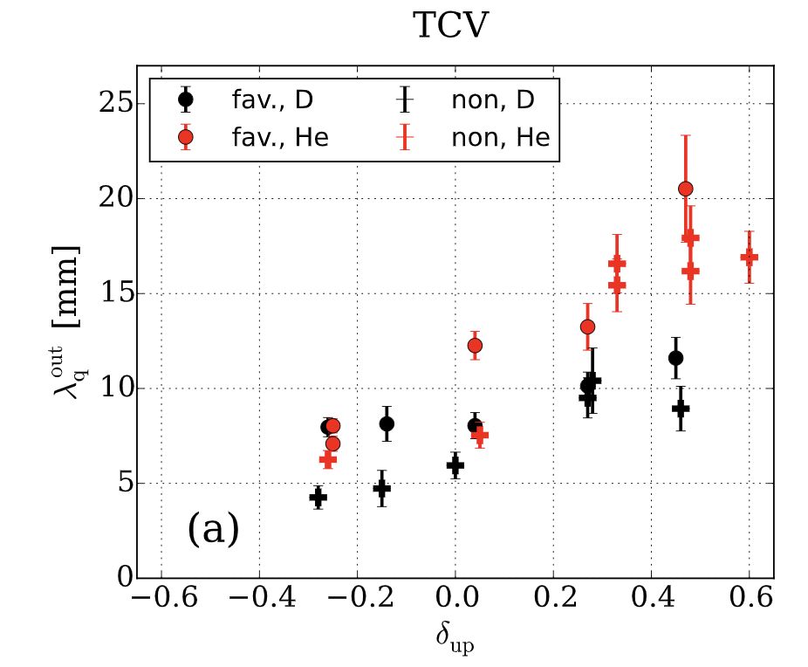
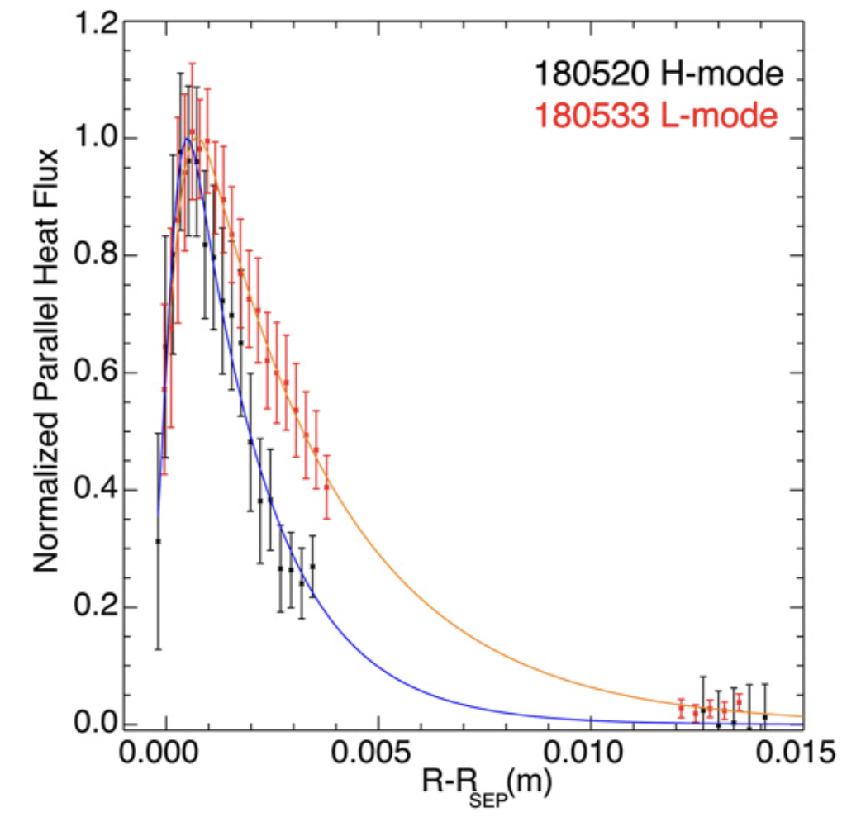
Target heat flux widths are larger in NT than PT
Given lower turbulence levels in NT, $λ_{q}$ may also be smaller
Indeed, observed on TCV [Faitsch et al, PPCF 60 (2018) 045010]
Consistent with GPI results by [Han et al, NF 61 (2021) 034003]
DIII-D diverted NT plasmas from 2019 had $λ_{q}$ close to Eich scaling for H-mode (1 shot), and 50% larger $λ_{q}$ in L-mode (most shots)
Generally favorable outlook [Marinoni et al 2021 NF61 116010]
Ongoing AUG IR camera analysis suggests results roughly in line with this [K. Lee, M. Faitsch]
Faitsch et al, PPCF 60 (2018) 045010
Marinoni et al 2021 NF61 116010

Slide 15
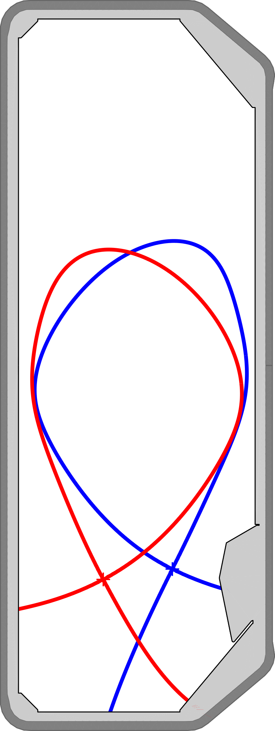
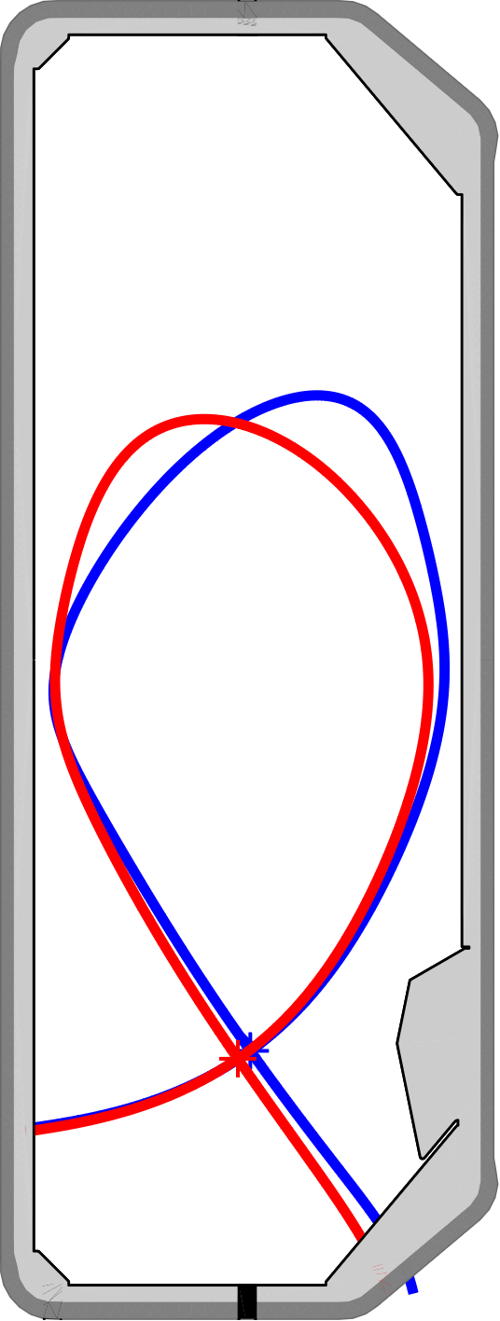
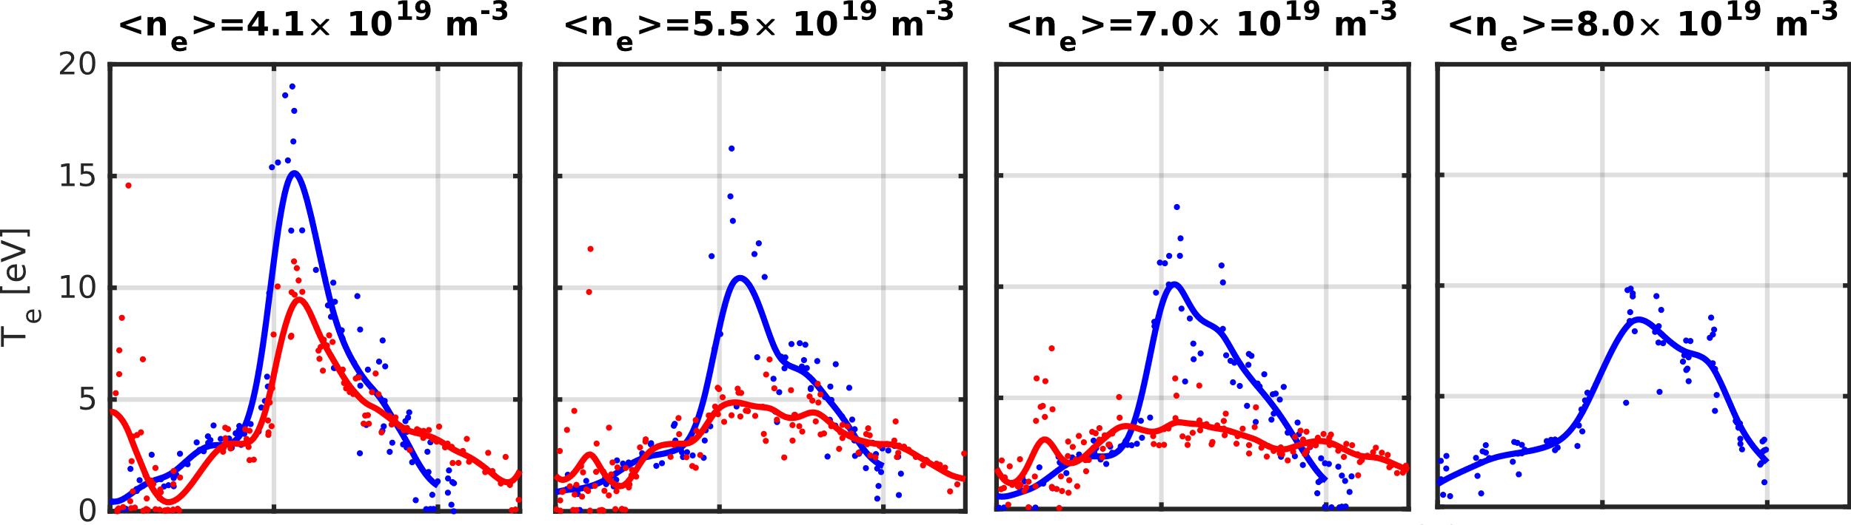
Comparing detachment in TCV NT/PT
Courtesy of O. Février
Configuration mirrored around R₀=0.88m - NT (Negative Triangularity) : δ_{top} ≈ -0.30, δ_{bot} ≈ -0.27 - PT (Positive Triangularity) : δ_{top} ≈ 0.27, δ_{bot} ≈ 0.29
Enhanced confinement & no jsat roll-over in NT case with D puff
NT targets consistently hotter even when puffing N2
Detachment achieved, but with core confinement degradation
Neither the variation in conn. lengths nor different divertor geometries appear to fully account for observed differences in detachment dynamics between NT and PT
PT NT
BxgradB
Increasing ${\overline{n}}_{e}$
PT NT
T_{e} [eV]
Fueling valve
$$ρ_{ψ}$$
$$ρ_{ψ}$$
$$ρ_{ψ}$$
$$ρ_{ψ}$$

Slide 16
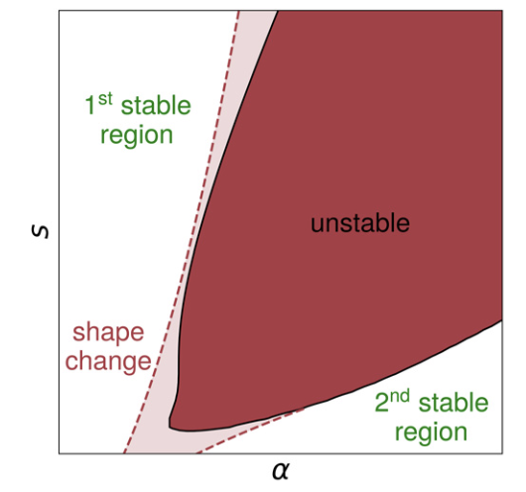
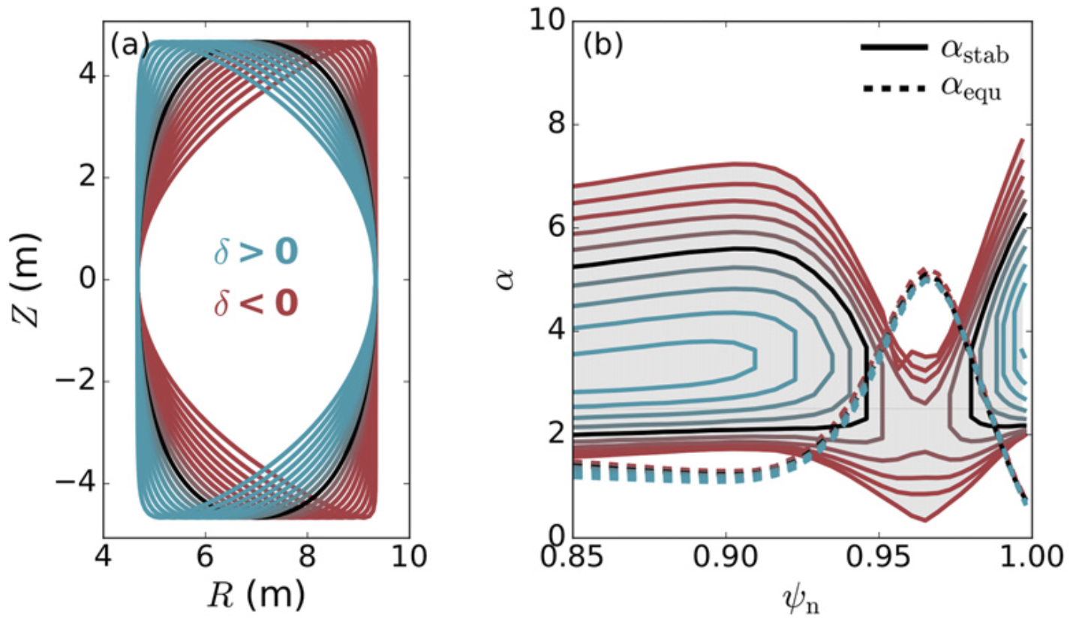
How robust is L-mode operation in NT plasmas?
On DIII-D, only forward-field has been explored so far (with diverted shape), always with robust L-mode (up to 13 MW of NBI)
On AUG, NT plasmas are robustly into some poor H-mode state: small ELMs, deep Er, peeling-ballooning limited [Happel, accepted NF 2022]
DIII-D NT plasmas have been shown to remain in L-mode because of $∞$-n ballooning mode limits
RHS illustrates principle of H-mode inhibition in NT
Saarelma et al., PPCF 63 (2021) 105006
Nelson et al., Nucl. Fusion 62 (2022) 096020

Slide 17
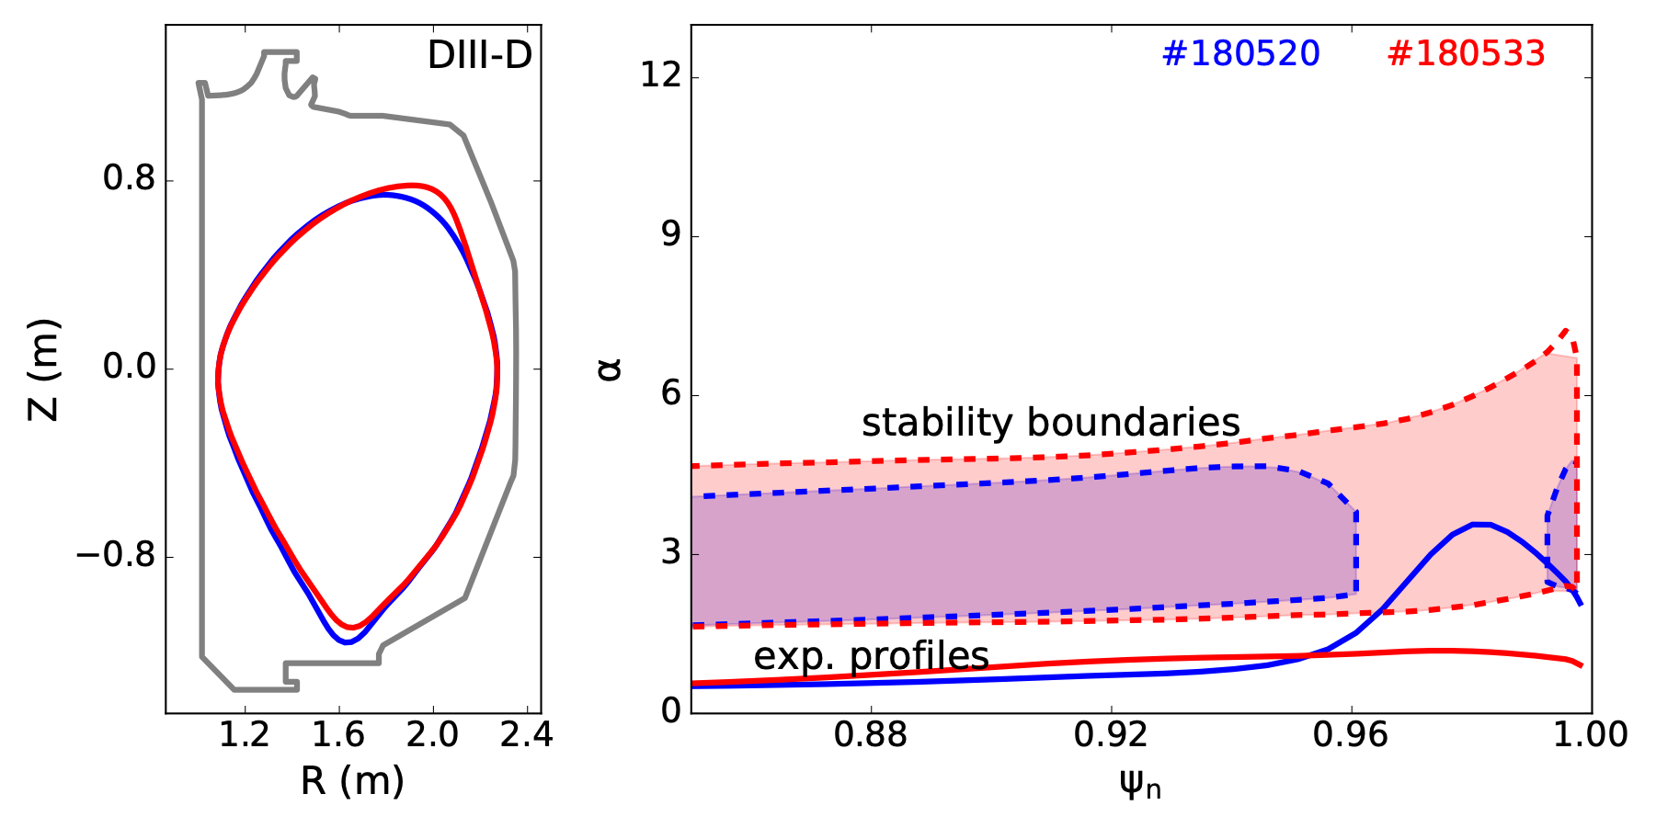
NT plasmas in DIII-D are limited by $∞$-n ballooning modes
H-mode
L-mode
Courtesy O. Nelson, Columbia
DIII-D cases that stayed in L-mode were $∞$-n ballooning unstable
Saarelma et al., PPCF 63 (2021) 105006
Nelson et al., Nucl. Fusion 62 (2022) 096020

Slide 18
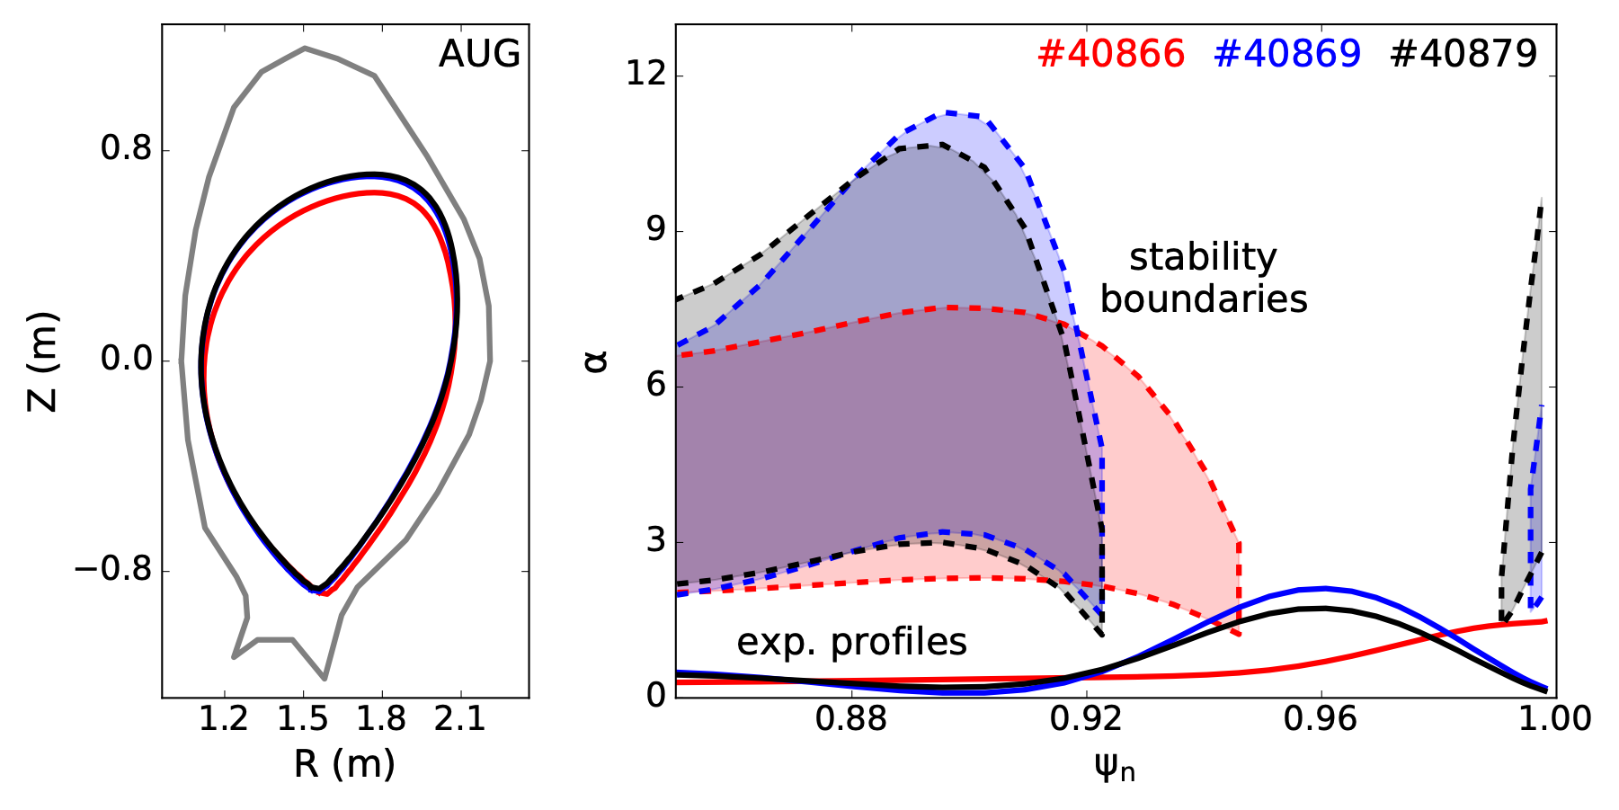
BALLOO finds open access to 2nd stability in AUG cases
Courtesy O. Nelson, Columbia
AUG cases did not achieve robust suppression of H-mode access in the 2nd stability region

Slide 19
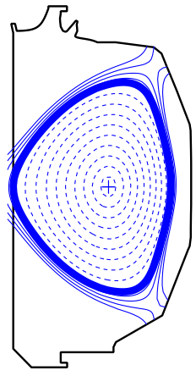
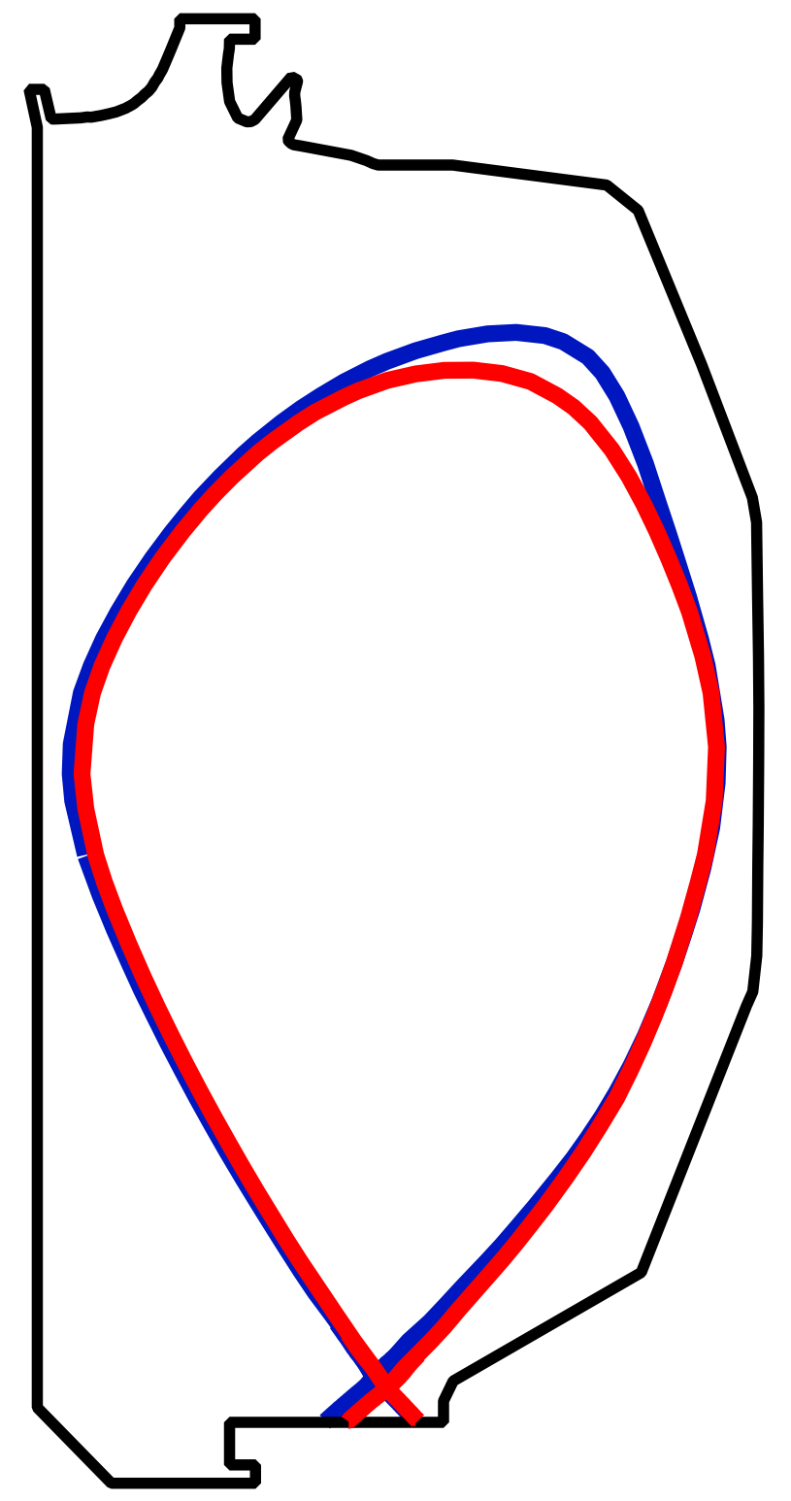
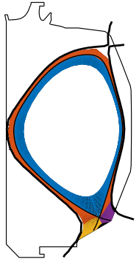
DIII-D is about to embark on its NT armored campaign
Core Scenario
(strongly shaped, wrong edge)
Edge Scenario
(right edge, weaker shape)
Limited:
H₉₈=1.3
@ β_{N}=2.8
Diverted:
L-mode
@ P/P_{LH}>5
Right Core
(Strongly Shaped)
Right Edge
(Robust L-mode)
Analogous to AUG studies
Project:
Temporary carbon armor tiles
(blocking diagnostics)
Courtesy C. Paz-Soldan, Columbia

Slide 20
DIII-D armored NT campaign plans
Principal Physics Questions to Answer in Diverted Neg-D Scenario:
Is high core performance achievable? β limit? τ_{E} scaling?
Does core transport & stability modeling capture the observations?
Are ELMs robustly avoided in all regimes? P_{L-H} scaling?
Does ballooning (in)stability model match findings?
Can high f_{rad} / low P_{sol} be realized with good confinement?
Is impurity transport understandable? Is stability good enough?
Does turbulence or orbit effects set heat flux width? λ_{q} scaling?
Courtesy C. Paz-Soldan, Columbia

Slide 21
Summary & Conclusions
International NT research with continued interest for core-edge integration prospects
AUG and TCV have recently completed WPTE RT07 experiments
- AUG results came short of our hopes, but analysis offers important validation
- TCV pioneered the subject and continues to invest on it
DIII-D will soon launch its NT armored-wall campaign
- likely to have significant impact on the field
- currently scheduled for late-October/early-November

Slide 22
OK… now some REAL Conclusions
Core reduced modeling of NT plasmas via TGLF has been validated vs. GENE and CGYRO
Opportunity for extensive predictive modeling; what we don’t measure (e.g. matched shapes), we can see in modeling
Predictive modeling does not shine an optimistic light
Both DTT and DEMO work suggests reduced performance at NT
TCV and DIII-D show great performance at NT. Why?
Lower triangularity may explain why better than AUG. But predictive modeling suggests this doesn’t scale well to reactor.
C-wall results in higher Zeff. On DIII-D, diverted discharges had greater confinement degradation than IWL, correlated with lower Zeff.
Nonlocal effects at NT stabilize turbulence in TCV and DIII-D, but irrelevant in DTT and DEMO.

Slide 23
OK… now some REAL Conclusions
AUG experiments pushed our capabilities; results offer valuable learning
e.g. validation of TGLF, lack of fueling, detachment dependences on shaping, etc.
We believe that our latest experiments (unfav. direction) were always in H-mode. We have a decent explanation for this (low PB limits; open access to 2nd stability).
Post-mortem, we now believe/speculate that (maybe) we could have avoided 2nd stability by delaying heating, first forming NT shape.
How does our current experience reflect on the promise of NT?
We must wait and see the upcoming DIII-D NT experiments.
Good news: only a few weeks away. Bad news: only a few weeks long; quite ambitious.
DIII-D will address questions on Zeff, L-H transition, $τ_{e}$ scaling… but answers to some key issues raised for DTT and DEMO may not come soon.

Slide 24
Additional slides

Slide 25
Key questions remain unclear…
- Is the NT performance improvement a pedestal or core effect?
- If we stay in L-mode, can the gradients be high enough to catch up on a PT H-mode?
- Is the NT high performance in TCV and DIII-D causally related to their C wall / high Zeff?
- ….
Is it a matter of BCs or is core transport really different?
PT
PT
NT
NT
$$ρ_{p}$$
$$1$$
$$ρ_{p}$$
$$1$$

Slide 26
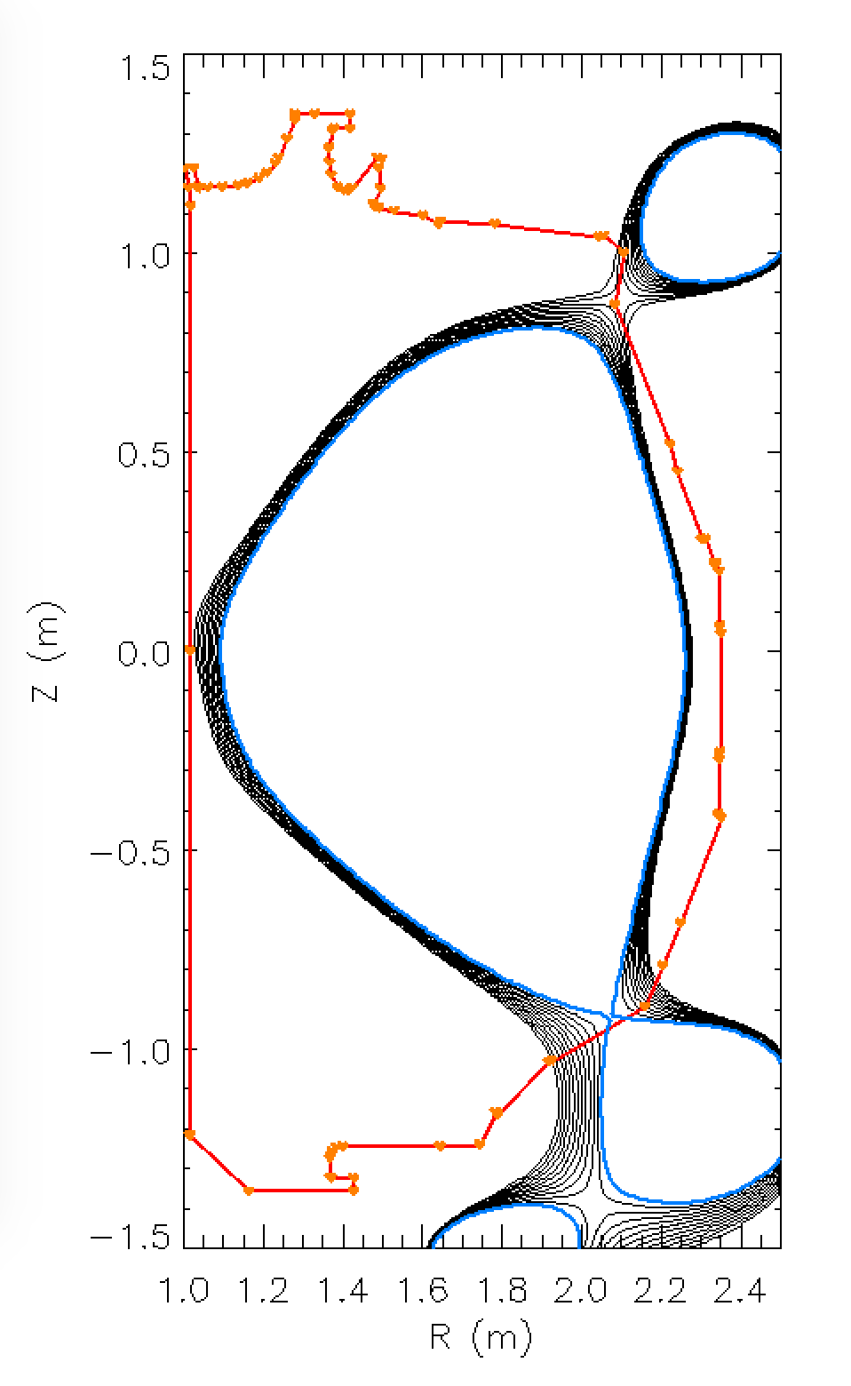
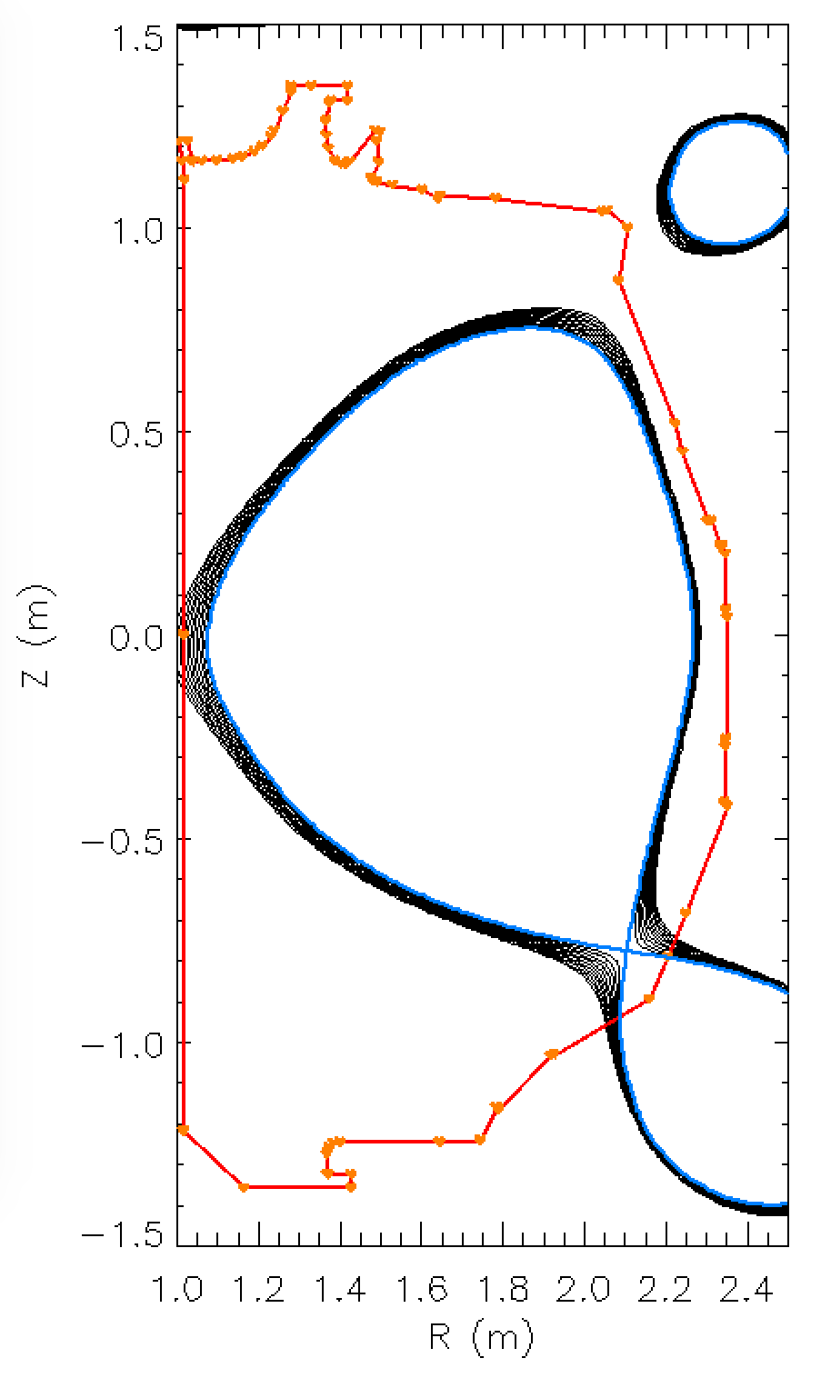
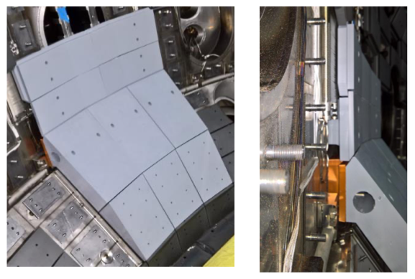
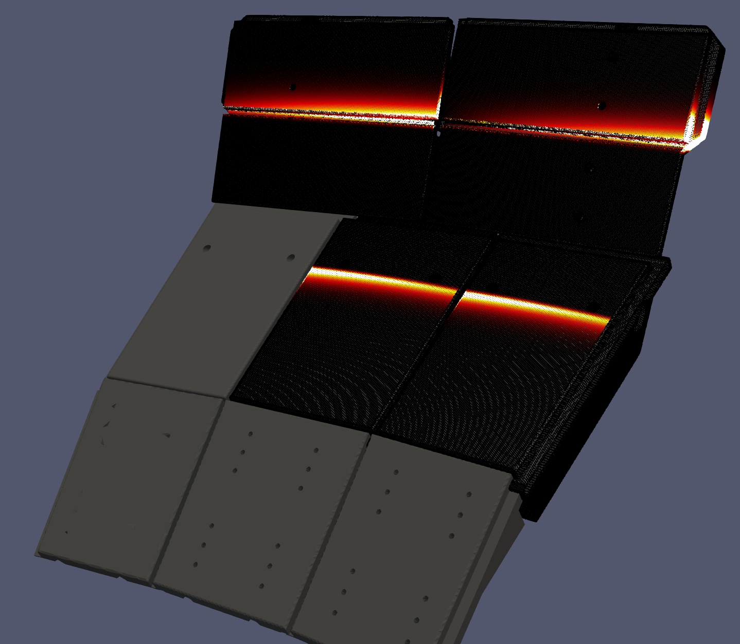
DIII-D is about to embark on its NT armored campaign
NT armored campaign relies on new (temporary) carbon tiles to protect HFS wall damage
- several diagnostic views blocked
- project lasting ~3 weeks
Courtesy C. Crowe, GA
Courtesy T. Looby, ORNL

Slide 27
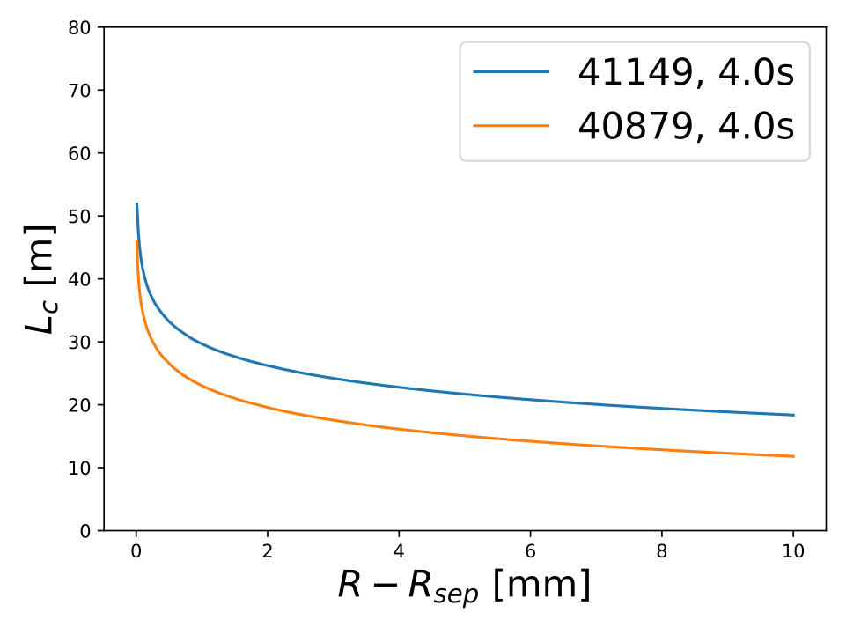
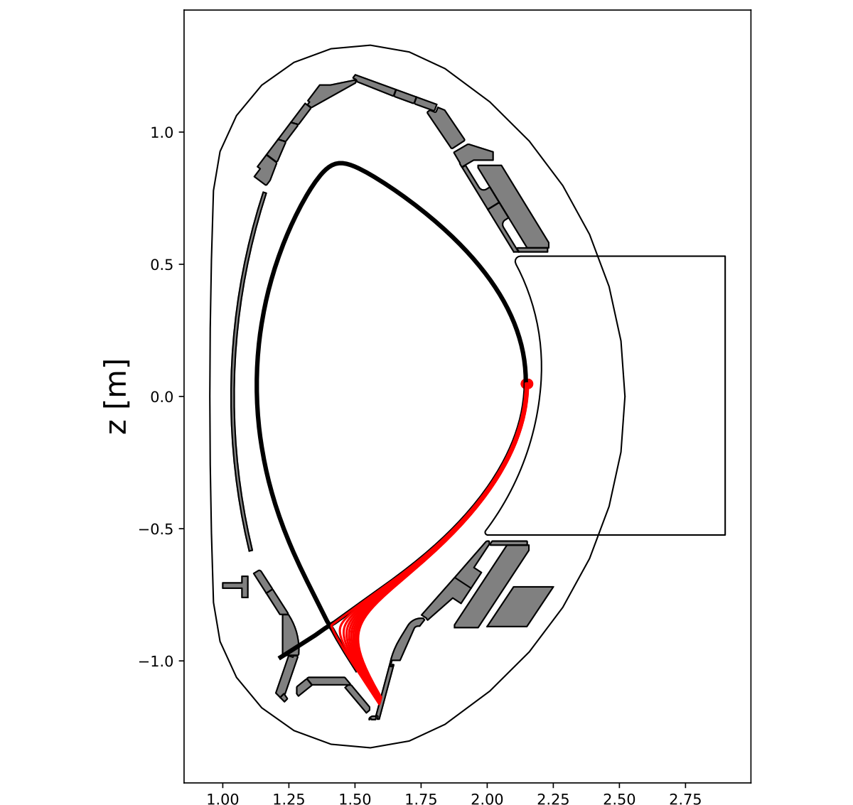
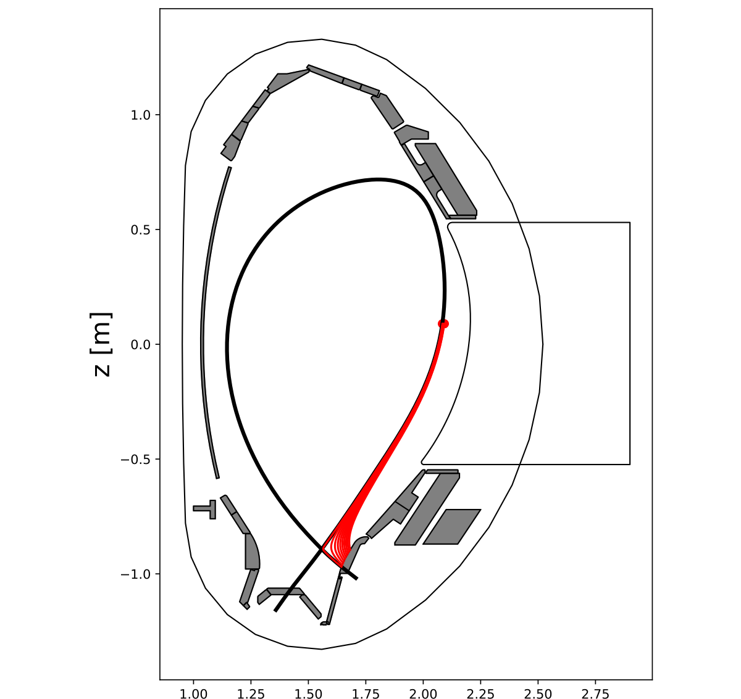
LFS connection lengths are smaller at NT, likely impacting SOL impurity transport, turbulence, pedestal stability, …
PT
NT

Slide 28
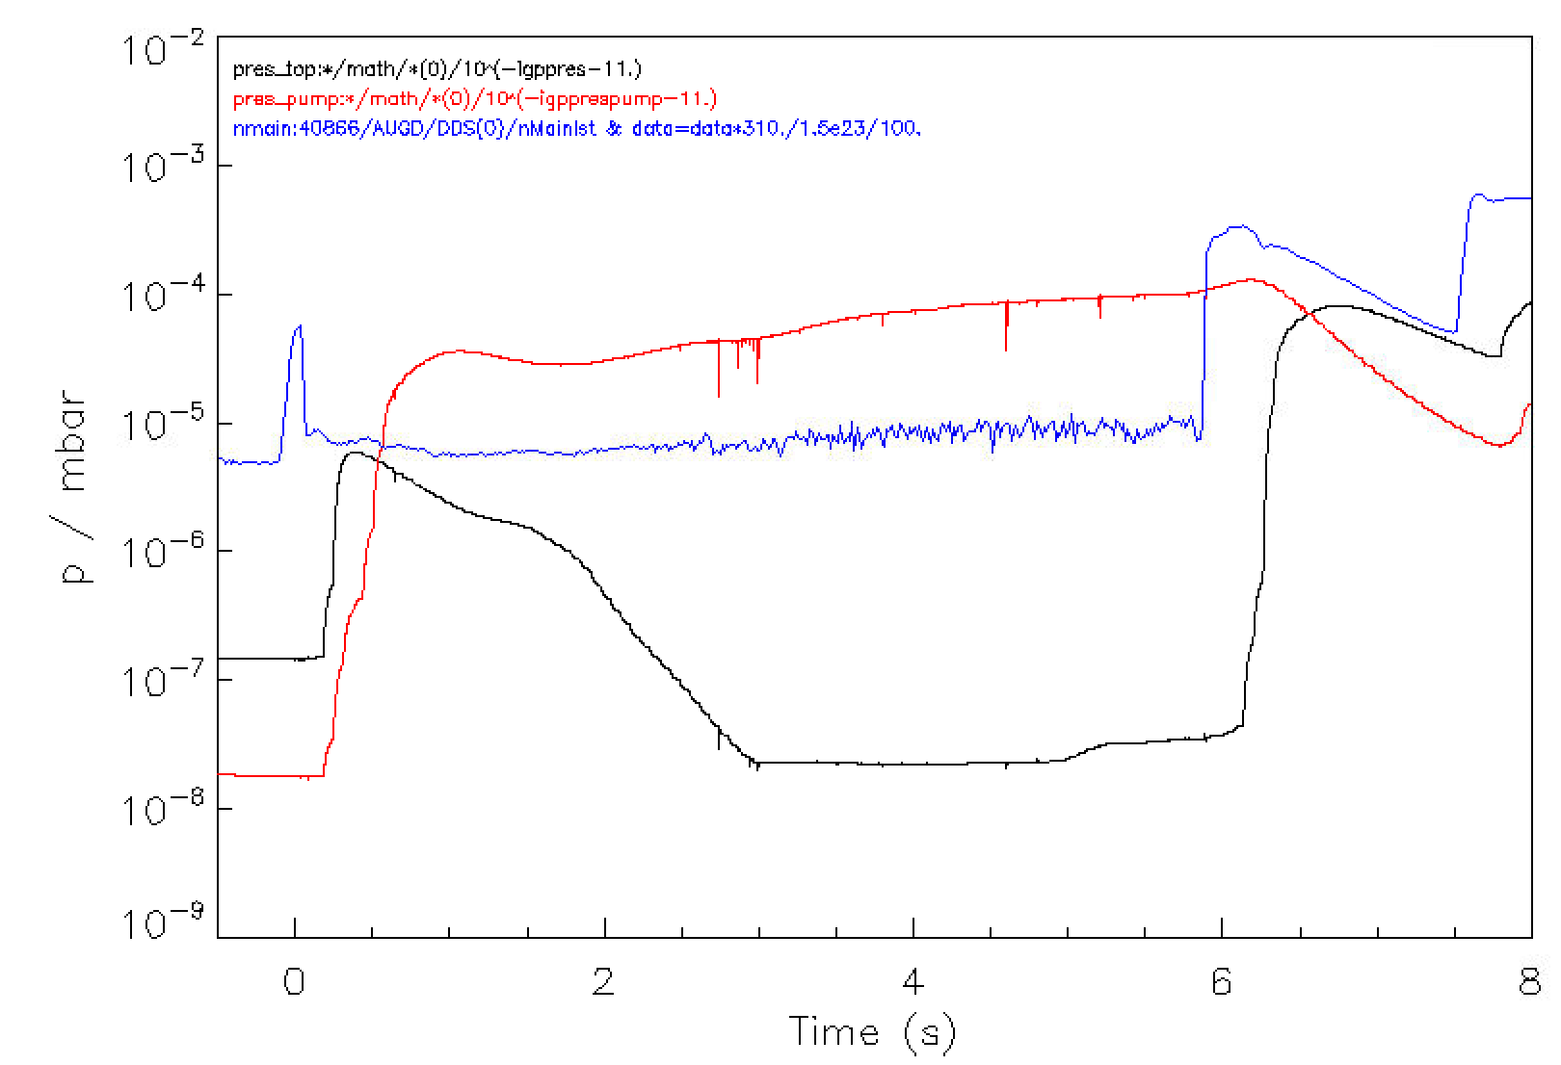
Neutral plugging in the upper vessel
A. Kallenbach pointed out that NT discharges at AUG typically have extremely low pressure in the upper part of the vessel
Pressures of ${10}^{−8}$ mbar, basically vacuum… Never observed at $δ>0$
Effect likely relates to suppressed recycling
Upper SOL must be thin
neutrals cannot reach upper vessel through midplane
Han et al. (NF 2021) reported reduced turbulence in the TCV SOL based on GPI. Connected?
bottom
midplane
top

Slide 29
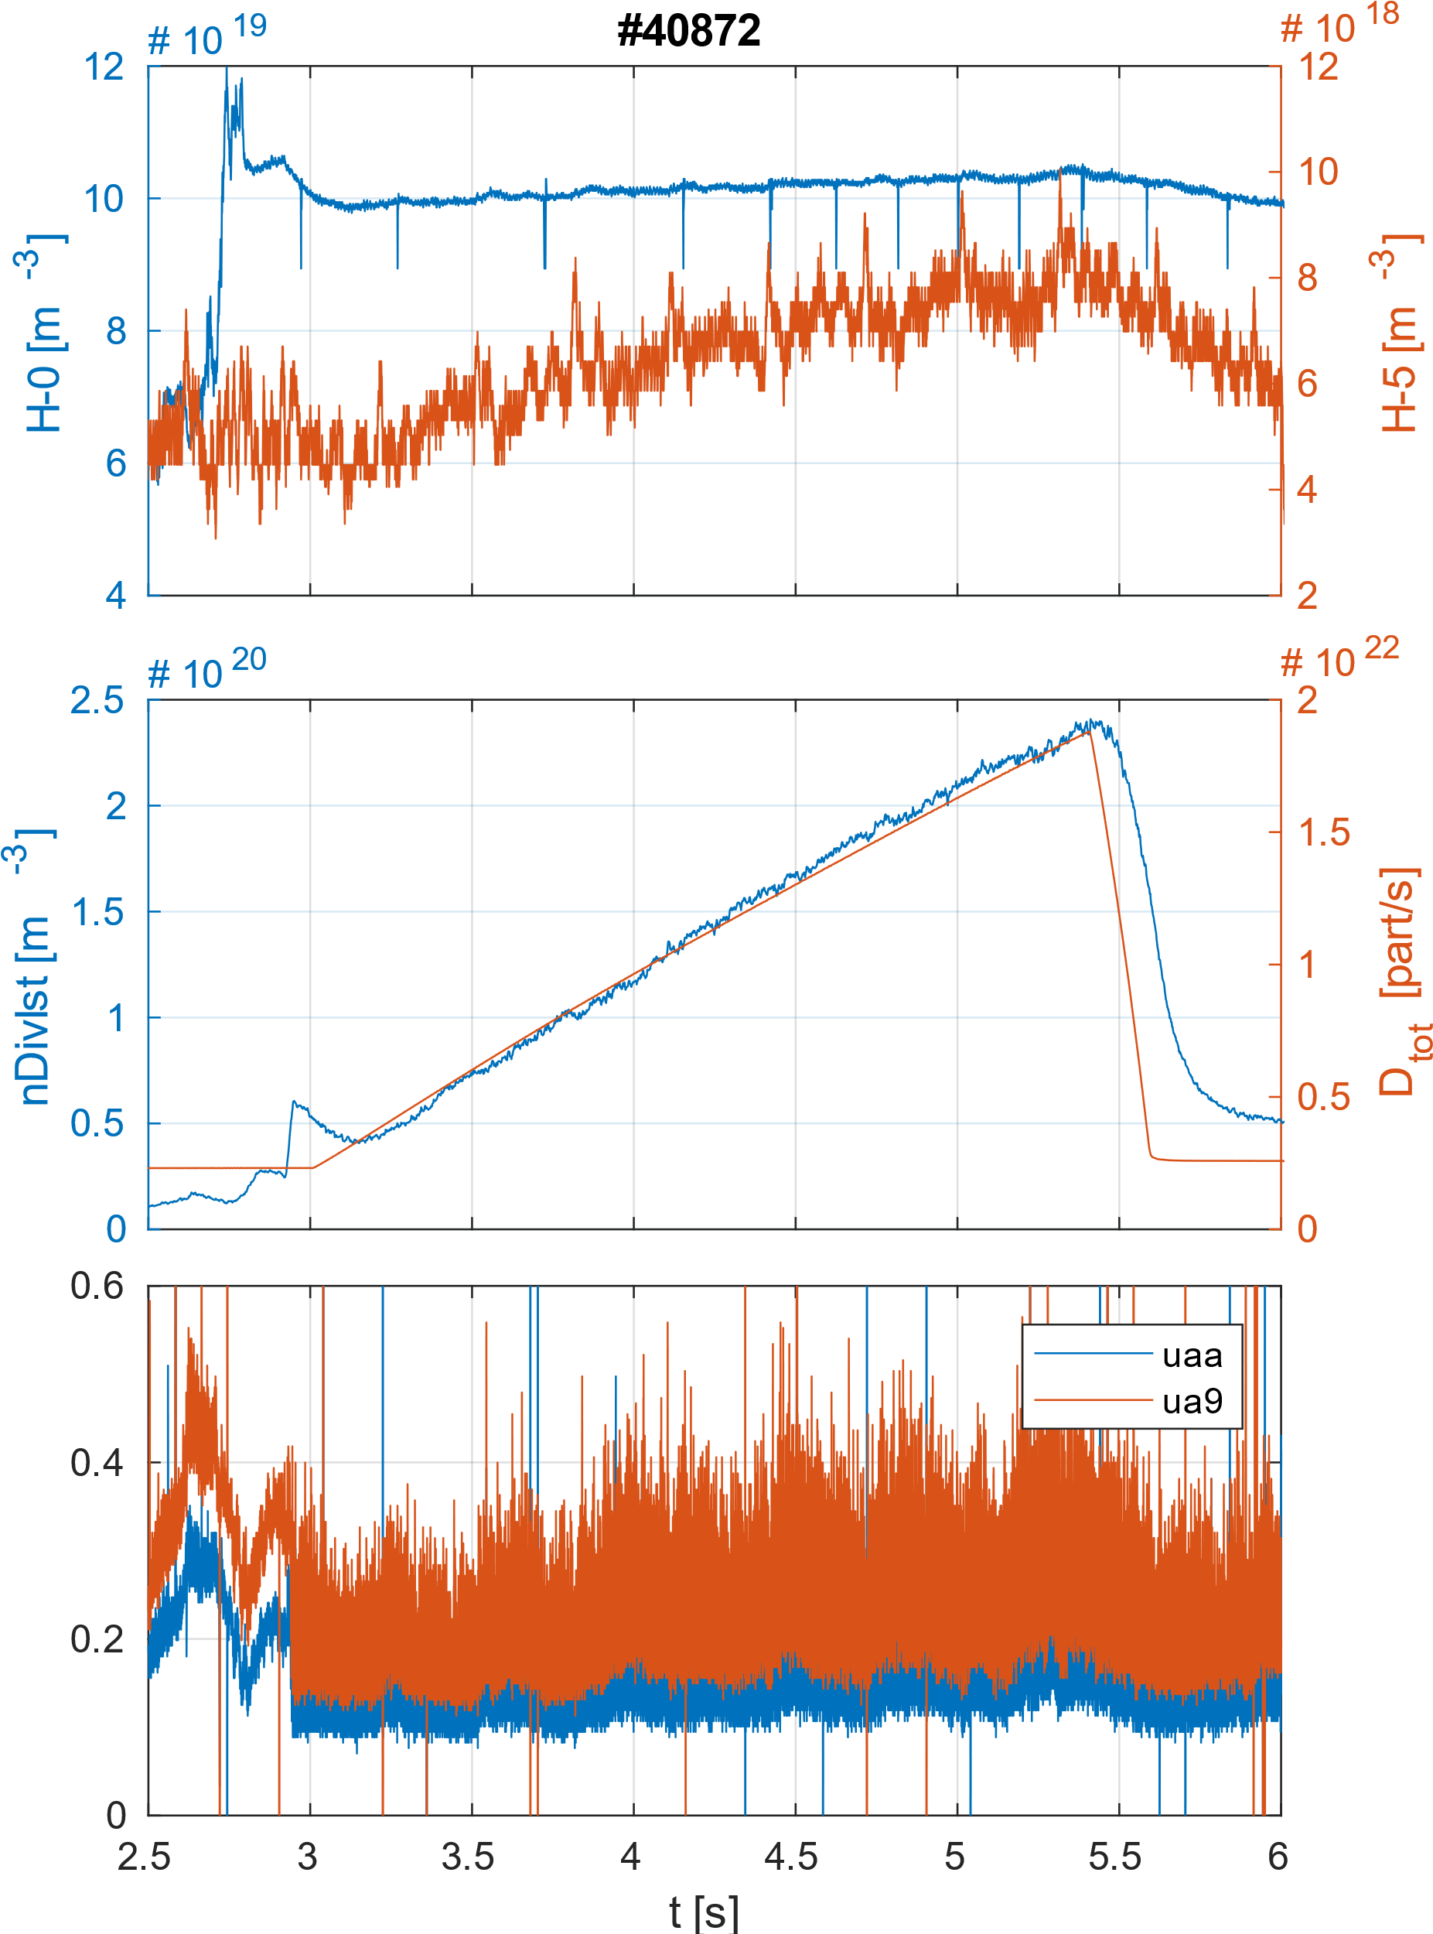
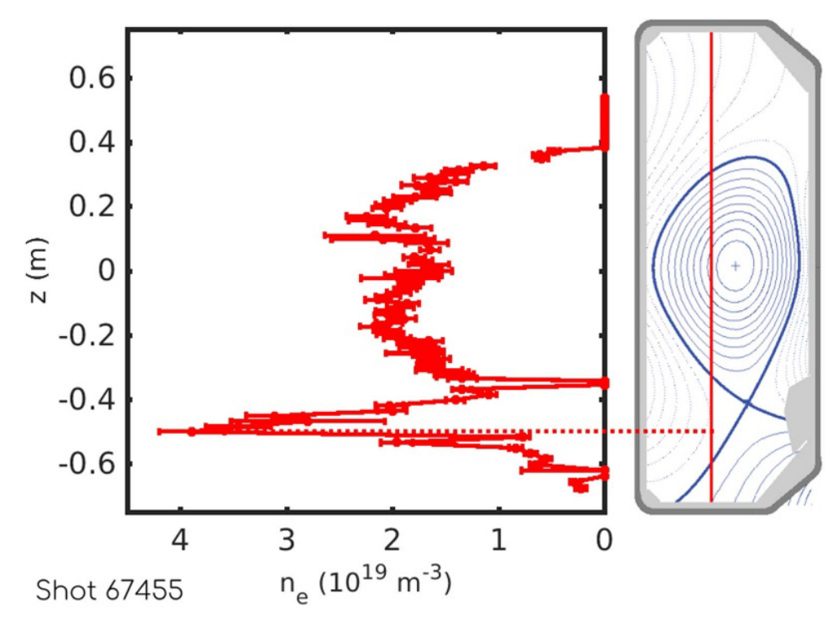
Attempts at detachment via gas fueling meet particle barrier
On both TCV and AUG, application of a gas puff (either at the midplane or in the divertor) could not efficiently fuel the core
Possible correlation with application of ECH (not understood)
Likely creation of a strong HFS high-density front
Coda et al 2022 Plasma Phys. Control. Fusion 64 014004

Slide 30
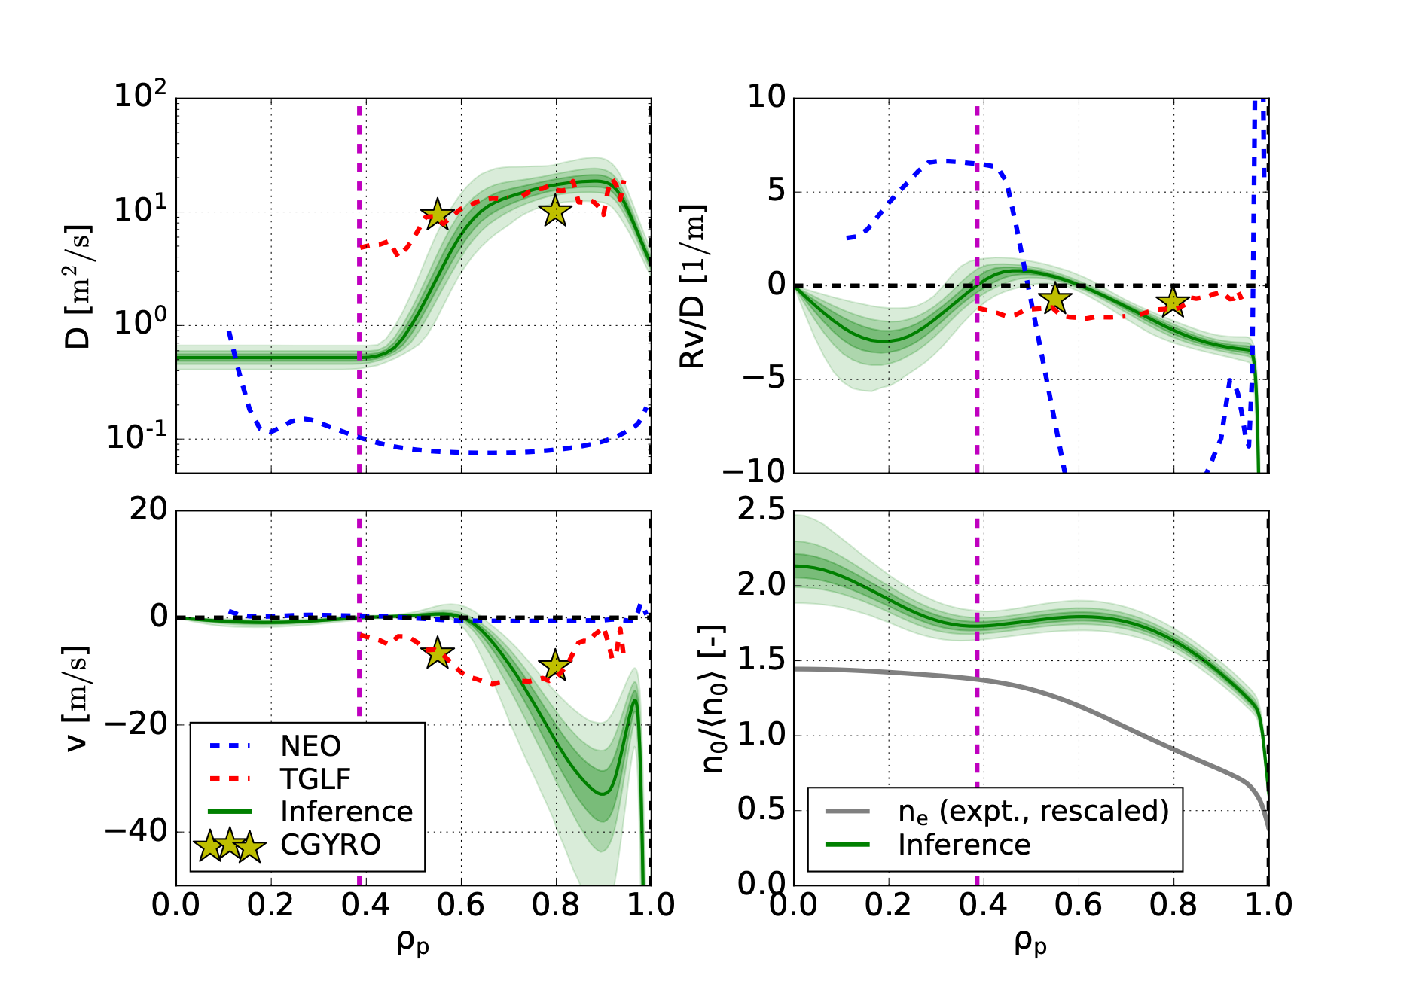
TGLF-SAT2 can accurately match CGYRO/GENE
Various case studies have shown reliability of quasilinear gyrofluid and gyro kinetic models, so far tested at PT, also at NT
- no show-stoppers found for predictive modeling activity in NT plasmas
F. Sciortino et al., “Investigation of Core Impurity Transport in DIII-D Diverted Negative Triangularity Plasmas”, submitted to PPCF [Jan 2022]

Slide 31
NT in DTT
P. Innocente’s slide on NT studies
P. Mantica’s results thus far — can lack of Te pedestal be compensated by core transport improvements?

Slide 32
Studies on NT DEMO are not optimistic…
Examination of NT opportunities for DEMO by E. Fable, F. Palermo et al. have shown that there is little gain/promise (using TGLF SAT-0 first, SAT-1 later)
Inverting the triangularity for an H-mode DEMO (Tped ~ 5 keV), the fusion power improves by ~200 MW
Reducing the pedestal from 5 to 1 keV, the fusion power is not compensated by changes in transport
Pedestals below 4 keV are not very attractive, except if core density can be increased above ~${10}^{20}m^{-3}$

